Slide 1

INTRODUCTION
Drawing: The graphical representation of any object or idea can be termed as drawing. A drawing can be prepared either using free hand or using engineering instruments or using computer program.
Types of Drawing:
1. Artistic Drawing 2. Engineering Drawing
1.Artistic Drawing
The drawing representing any object or idea which is sketched in free hand using imagination of artist and in which proper scaling and dimensioning is not maintained is called an artistic drawing. Example: Painting, Posters,arts etc.

Slide 2
INTRODUCTION
Engineering Drawing:
Engineering drawing can be defined as…
A graphical language used by…
engineers and other technical personnel
associated with the engineering profession which fully and clearly defines the requirements for…
engineered items.
It is a two dimensional representation of a three dimensional object.

Slide 3
INTRODUCTION
In other words,
The art of representing a real or imaginary object precisely using some graphics, symbols, letters and numbers with the help of engineering drawing instruments is called engineering drawing.
The art of representing engineering objects such as buildings, roads, machines, circuits etc. on a paper is called engineering drawing.
It is used by engineers and technologists. An engineering drawing provides all information about size, shape, surface type, materials etc. of the object
Example:
Building drawing for civil engineers,
Machine drawing for mechanical engineers,
Circuit diagrams for electrical and electronics engineers,
computer graphics for one and all etc.

Slide 4
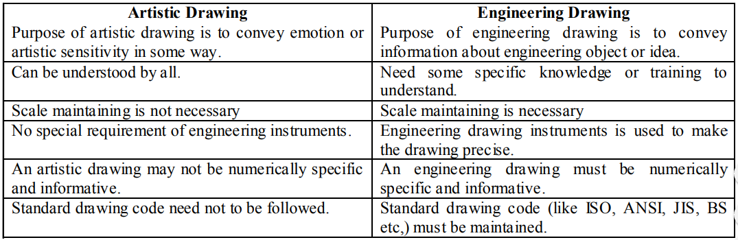
INTRODUCTION
Difference Between Artistic and Engineering Drawing

Slide 5
INTRODUCTION
Purpose of Engineering drawing
It is very difficult and complex to explain some certain engineering requirements in word.
In such cases well dimensioned and properly scaled graphics can make it easy to understand that for technical personnel.
Engineering drawing serves this purpose. Any product that is to be manufactured, fabricated, assembled, constructed, built, or subjected to any other types of conversion process must first be designed.
To make the outcome from the design understandable to any third party engineering drawing is the best way.

Slide 6
INTRODUCTION
Applications of Engineering Drawing
Engineering drawing is an essential part of almost all engineering projects. Some important uses of engineering drawing are mentioned below:
It is used in ships for navigation.
For manufacturing of machines, automobiles etc.
For construction of buildings, roads, bridges, dams, electrical and telecommunication structures etc.
For manufacturing of electric appliances like TV, phone, computers etc.

Slide 7
INTRODUCTION
Types of Engineering Drawing
Engineering drawing can be grouped into following 4 major categories:
1. Geometrical Drawing a. Plane geometrical drawing b. Solid geometrical drawing
2. Mechanical Engineering Drawing
3. Civil Engineering Drawing
4. Electrical & Electronics Engineering drawing etc.

Slide 8
INTRODUCTION
Types of Engineering Drawing
Geometric Drawing
The art of representing geometric objects such as
rectangles,
squares,
cubes,
cones,
cylinders,
spheres etc. on a paper is called geometric drawing.
If the object has only 2 dimensions i.e. length and breadth (as rectangles, squares, triangles etc.), it is called Plane geometrical drawing.
And if it has 3 dimensions i.e. length, breadth and thickness/depth (as cube, prism, sphere, cylinder etc.), it is called Solid geometrical drawing.

Slide 9
INTRODUCTION
Types of Engineering Drawing
Mechanical Engineering Drawing
The art of representing mechanical engineering objects such as machines, machine parts etc. on a paper are called mechanical engineering drawing or machine drawing.
It is used by mechanical engineers to express mechanical engineering works and projects for actual execution.

Slide 10
INTRODUCTION
Types of Engineering Drawing
Civil Engineering Drawing:
The art of representing civil engineering objects such as buildings, roads, bridges, dams etc. on a paper are called civil engineering drawing.
It is used by civil engineers to express civil engineering works and projects for actual execution.

Slide 11
INTRODUCTION
Types of Engineering Drawing
Electrical Engineering Drawing:
The art of representing electrical engineering objects such as motors, generators, transformers, wiring diagrams etc. on a paper are called electrical engineering drawing.
It is used by electrical engineers to express electrical engineering works and projects for actual execution.
The art of representing electronic circuits of TV, Phones, computers etc. on a paper are called electronic engineering drawing or electronic drawing

Slide 12
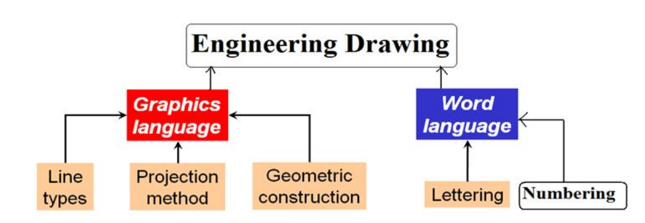
INTRODUCTION
Elements of Engineering Drawing

Slide 13
INTRODUCTION
Drawing Standards
An engineering drawing should be well specified and universally acceptable. That’s why there are some specified rules for engineering drawing.
These rules may vary slightly for different regions.
There are some drawing standards or drawing codes that accumulates the rules of engineering drawing for a certain region.
Well-known drawing codes and their application region is expressed below

Slide 14
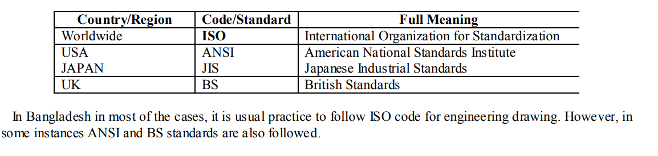
INTRODUCTION

Slide 15
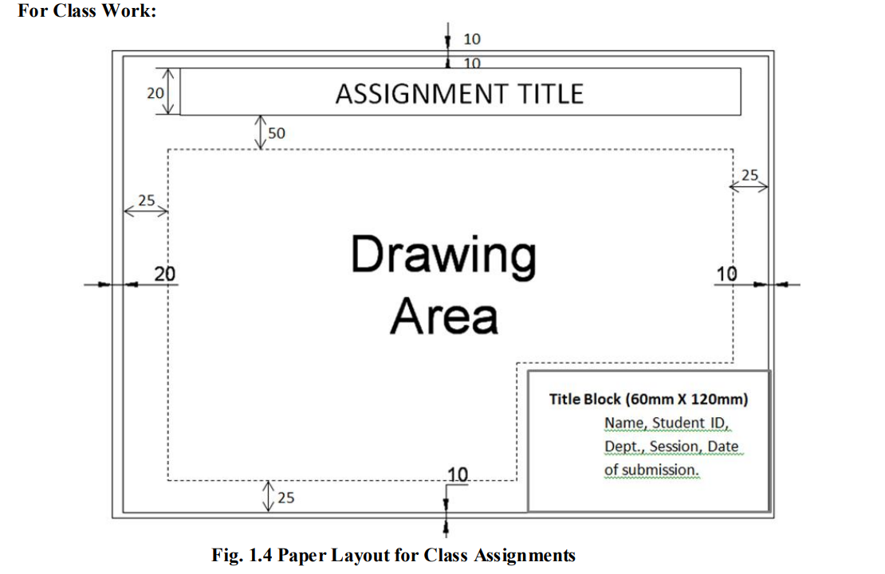
INTRODUCTION(Layout)

Slide 16
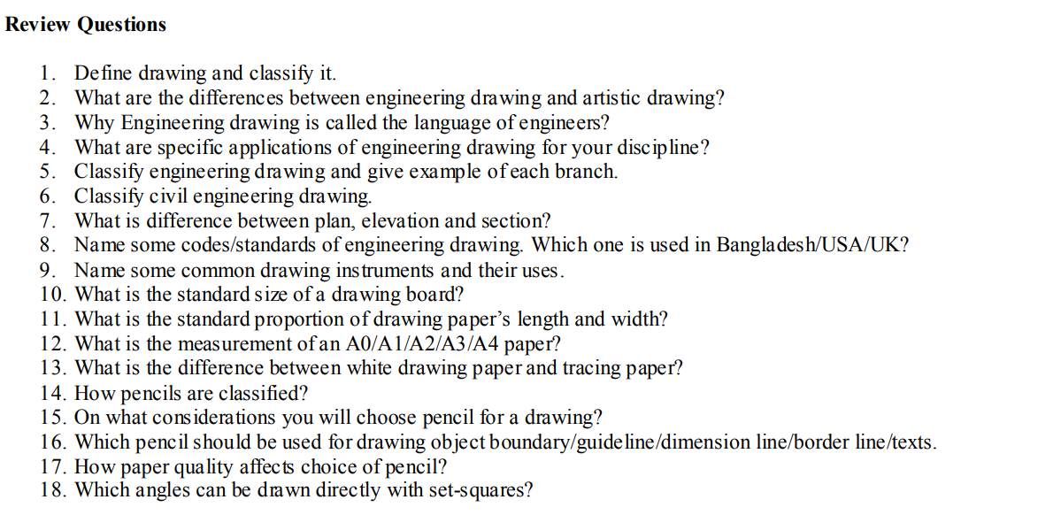
INTRODUCTION(Layout)

Slide 17
THANK U

